Slide 1
Coronary Artery Disease Risk Prediction Using Machine Learning
Under the guidance of
Dr. Vibhav Prakash Singh
By-
Vaishali Jaiswal (2019CA27)
Ayushi Barfa (2019CA07)
Shivam Sharma (2019CA58)

Slide 2
Contents
Introduction
Objective & Motivation
Dataset Analysis
Methodology
Feature Selection
Data Partitioning & Classification
Result & discussions
Conclusion
Future Scope

Slide 3
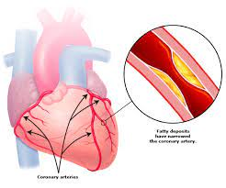
Introduction
Coronary Artery Disease (CAD) causes impaired
blood flow in the arteries that supply blood to the
heart. It is one of the major cause of mortality.
According to WHO it is taking 17.9 million lives each year globally.
Machine Learning could offer a way to address these challenges and facilitate automatic cardiac CT analysis with consistent and accurate results.

Slide 4
Objective and Motivation
The main objective of this project is to predict the risk of coronary artery disease.
And to reduce the amount of expensive pathological tests done just to predict the risk of this disease.
We must establish a proactive health care technology, so that we can prevent an irreversible damage.

Slide 5
Dataset Analysis
The dataset used in this project is Z- Alizadeh Sani medical dataset contains information about 303 patients as clinical records with 56 feature attributes.
The dataset consists of 216 records of CAD patients and 87 records of healthy persons with 55 independent feature attributes or predictors and one output or response variable.
The dataset used is based on classification problem with the target variable having values ‘CAD’ and ‘Normal’ with no missing values.

Slide 6
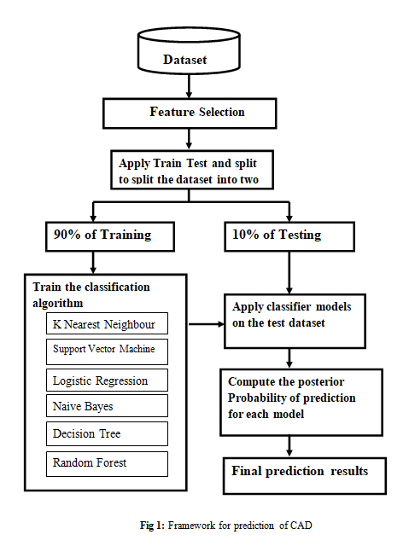
Methodology

Slide 7
Feature Selection
Number of feature in this project was 56 but as we convert the categorical data into dummy or indicator variables it classified into sub features will become 79 features.
The feature selection method applied in this project are as follows:
S no | Feature Selection Method | Number of Features Selected
1 | Remove constant features | 78
2 | Remove quasi-constant features | 73
3 | Remove correlated features | 56
4 | Univariate Selection | --
5 | Univariate roc auc or mse | 30
Table 1: Feature selected

Slide 8
Data Partitioning & Classification Models
The dataset is randomly divided into a training subset and testing subset with the selected features for the development of classifiers. The dataset is split into two parts with 90% of data for training and 10% for testing.
. There are six widely used supervised machine learning algorithm implemented for classification modelling in this project. These algorithms are:
K-Nearest Neighbour
Support Vector Machine
Naive Bayes
Decision Tree
Random Forest.

Slide 9
Results and Discussions
Algorithm | ACC% | Precision | Recall (sensitivity) | F-score
K-NN | 70.97 | 0.68 | 1.0 | 0.81
SVM | 87.1 | 0.83 | 1.0 | 0.90
Logistic Regression | 83.87 | 0.82 | 0.95 | 0.88
Naive Bayes | 70.97 | 1.0 | 0.55 | 0.70
Decision Tree | 93.55 | 0.90 | 1.0 | 0.95
Random Forest | 93.55 | 0.90 | 1.0 | 0.95
Table 2: Performance metrics of the ML models applied

Slide 10
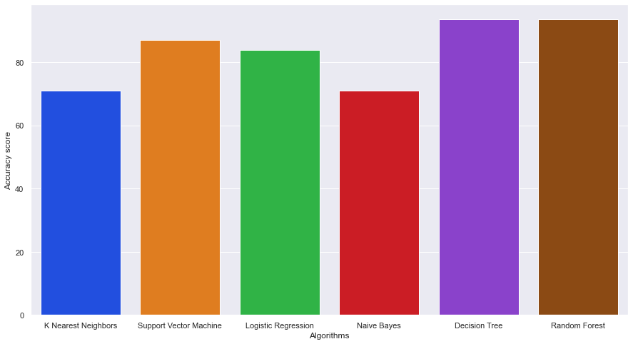
Fig 2: Classifier performance comparison with accuracy obtained in applying machine learning algorithms to the Z- Alizadeh Sani medical dataset

Slide 11
Conclusion
The six ML models performed well, with accuracies found to be greater than 70.9 % and among all of them Random Forest and Decision Tree found with highest accuracy of 93.55 %.
The feature selection algorithm also reduced the number of unnecessary pathological tests.
Although CAD is both widely prevalent and may lead to fatal consequences, timely detection of CAD would empower clinicians to treat modifiable risk factors associated with the progression of CAD.

Slide 12
Future Scope
We hope that as more datasets are available for training and algorithm, we may be able to label ML algorithms as diagnostic steps in CAD management. Because machine learning utilizes the dataset of patients who have already been diagnosed, the predictive ability of an ML algorithm for CAD would improve as more data are supplied to the algorithm.
We look forward to gain access to larger datasets for further validation and refinement with the eventual goal of providing an open source solution to aid healthcare practitioners in the detection and treatment of CAD.

Slide 13
Thank you

